Slide 1
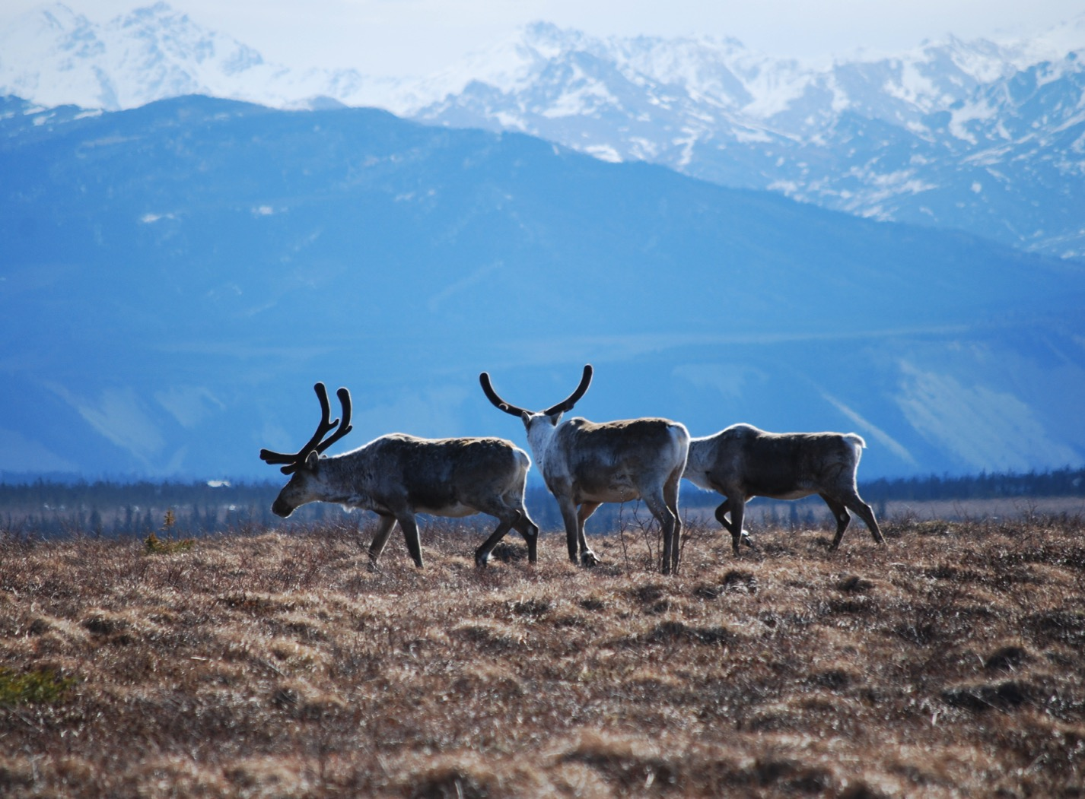
Arctic Boreal Vulnerability Experiment (ABoVE)
2017 ABoVE Airborne Campaign
26 May 2017 (DOY 146)
AirMOSS: Southwest Alaska
Charles Miller, Deputy Science Lead
Jet Propulsion Laboratory, California Institute of Technology
and the ABoVE Science Team For Hank Margolis, Eric Kasichke, Bruce Tagg
NASA HQ
May 2017

Slide 2
26 May 2017/DOY 146 Southwest Alaska
Assets Deployed:
Fairbanks (PAFA) – AirMOSS (P-band SAR)/JSC G-III (N992NA)
Pilots: Tom “T-Rex” Ryan, Scott “Bonz” Reagan, Tom “Duster” Parent
Science Coordinator: N Pinto
Science Lead: M Moghaddam
Project Manager: Y Lou
Mechanics: Johnny Scott, Jim Fennel
Operators: Phil Vaughn, Dave Elliot, Rocky Smith, Roger Chao, Joanne Shimada

Slide 3
26 May 2017/DOY 146 Southwest Alaska
Daily Summary:
Science Flight
6 lines of PLAN_1121 flown
Line 1 had to be attempted out of order as airplane could not get to altitude in time
PPA: Operated flawlessly today! We were able to get all six lines on flight plan 1121 as well as lines 1 (32607) and 6 (30203) from flight plan 1114.
RADAR: Recording glitch on line 3 (ID 28019) but data is believed to be recoverable.
Kasischke and Chen in the field at Delta Junction

Slide 4
26 May 2017/DOY 146 72-Hour Look Ahead
All plans weather dependent
Saturday 27 May 2017 (DOY 147):
Yukon-Kuskokwim Delta
https://uavsar.jpl.nasa.gov/cgi-bin/report.pl?planID=PLAN_1114_v01#flightPlan
Sunday 28 May 2017 (DOY 148):
Down Day
Monday 29 May 2017 (DOY 149):
Seward Peninsula
https://uavsar.jpl.nasa.gov/cgi-bin/report.pl?planID=PLAN_1116_v02#flightPlan

Slide 5
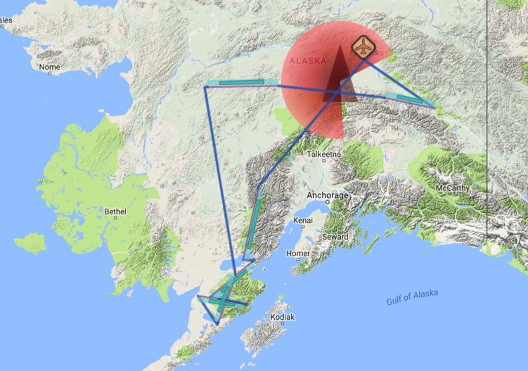
26 May 2017/DOY 146 Southwest Alaska
Flight Plan 1121 v01: Fairbanks AK (PAFA) – PAFA
https://uavsar.jpl.nasa.gov/cgi-bin/report.pl?planID=PLAN_1121_v01#flightPlan
Data Acquisitions:
Line 1, ID 19204: Iliamna
Line 2, ID 23002: Katami 1
Line 3, ID 28019: Katami 2
Line 4, ID 02110: Katami 3
Line 5, ID 08910: Poorman
Line 6, ID 10203: Delta Jnc
Line 7, ID 32607: Delta Junction
Line 8, ID 30203: Delta Junction
Lines 7 and 8 added from Plan 1114
P-band keep-out zone shown in RED
(centered on Clear, AK: 64.29 N, 149.19 W)
08910
10203
19204
23002
28019
02110
5/26/17 flight plan & acquisition segments

Slide 6
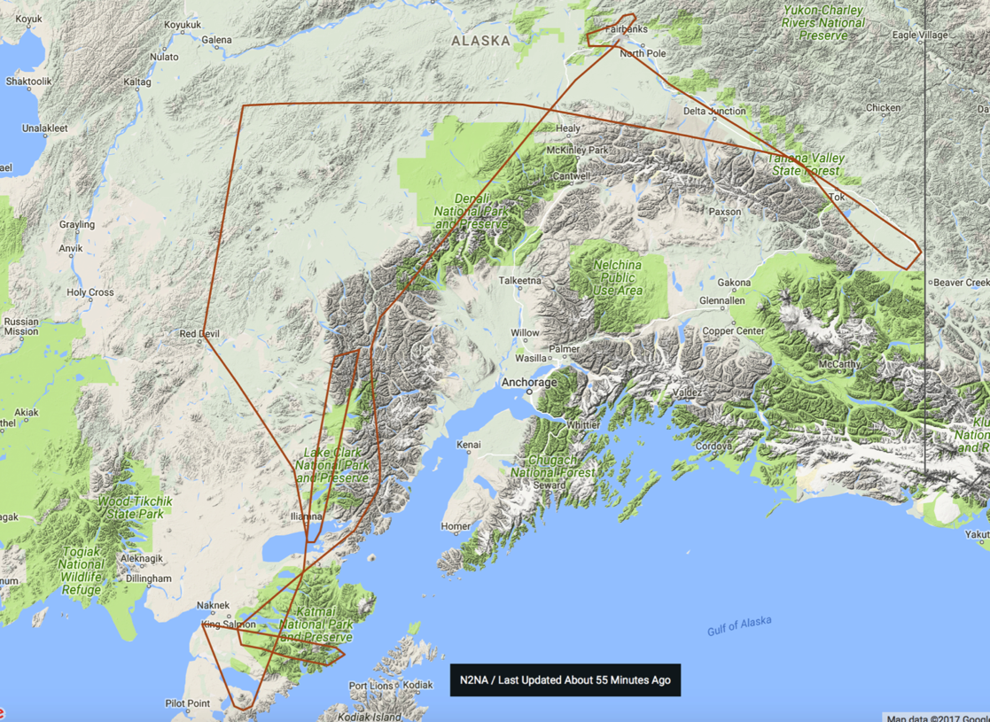
26 May 2017/DOY 146 Southwest Alaska
Actual Flight Lines
08910
10203
30203
32607
19204
23002
28019
02110

Slide 7
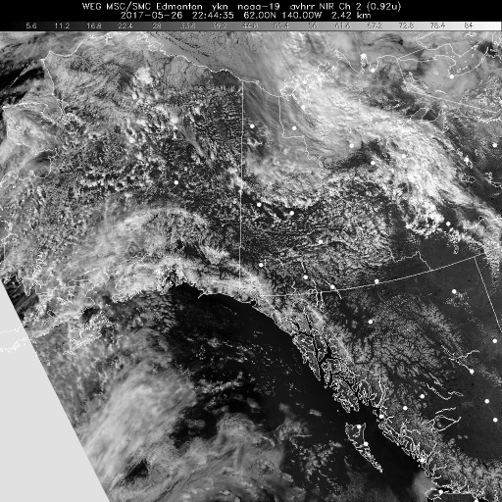
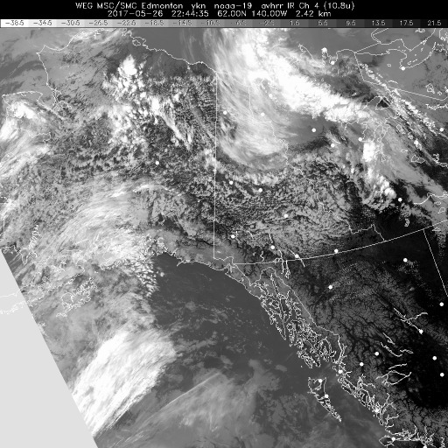
26 May 2017/DOY 146 Southwest Alaska
HRPT NIR 2244Z
HRPT IR 2244Z
HRPT NIR (left) and IR (right) show partly cloudy conditions across Alaska

Slide 8
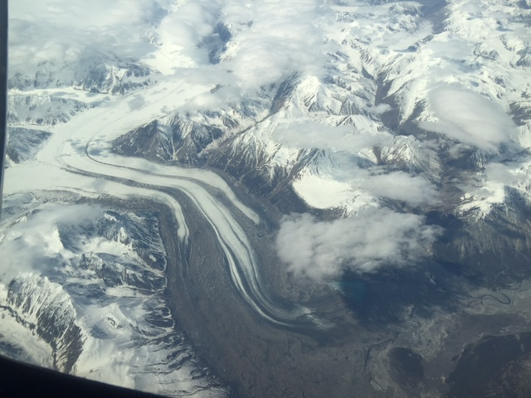
26 May 2017/DOY 146 Southwest Alaska
Glaciers in the Alaska Range as seen from N992NA
Stevens Village
Beaver
Kotzebue
Notes:
https://www.youtube.com/watch?v=aPVLyB0Yc6I

Slide 9
26 May 2017/DOY 146 Southwest Alaska
A
B
C
D
AirMOSS Quick-look products
A. Line 1, ID 19204: LCKARK
B. Line 2, ID 23002: Katami 1
C. Line 3, ID 28019: Katami 2
D. Line 4, ID 02110: Katami 3
Joanne Shimada, JPL
Notes:
Note the riverine vegetation structure in the rugged topography of the Katami NWR in SW Alaska

Slide 10
26 May 2017/DOY 146 Southwest Alaska
A
B
C
D
AirMOSS Quick-look products
A. Line 5, ID 08910: Poorma
B. Line 6, ID 10203: Delta Jnc
C. Line 7, ID 32607: Delta Jnc
D. Line 8, ID 30203: Delta Jnc
Joanne Shimada, JPL

Slide 11
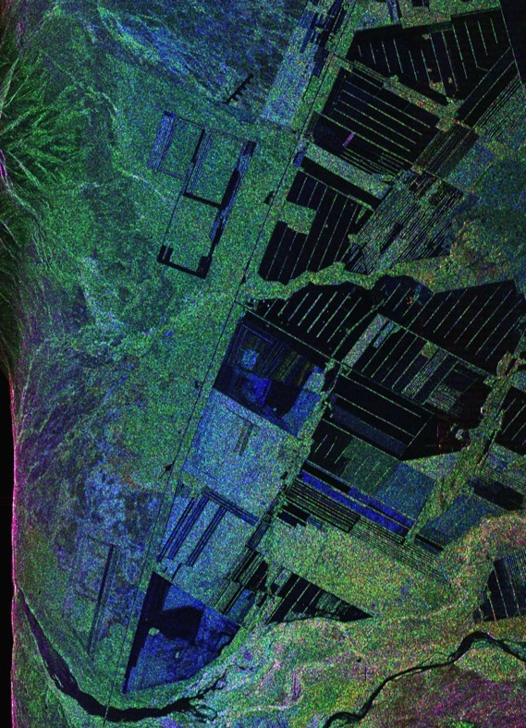
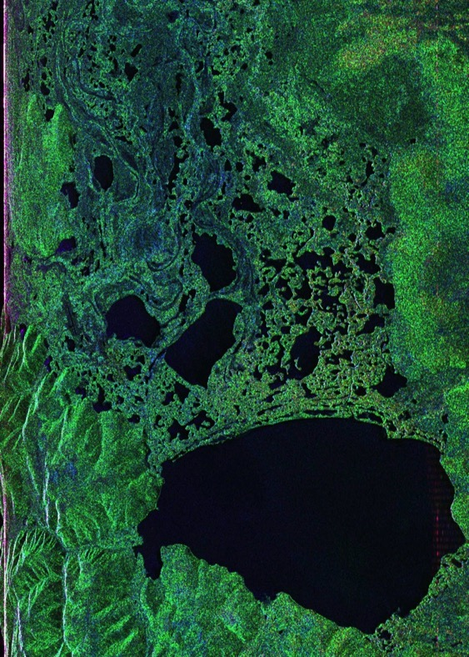
26 May 2017/DOY 146 Southwest Alaska – Details
10203
30203
Notes:
Line 10203 – Detail showing the finely resolved features in the agricultural plots in Delta Junction
Line 30203 – Detail showing a moderately large lake and its associated wetlands in the Delta Junction area

